Slide 1
Amazon’s Travel
Mary Girgis

Slide 2
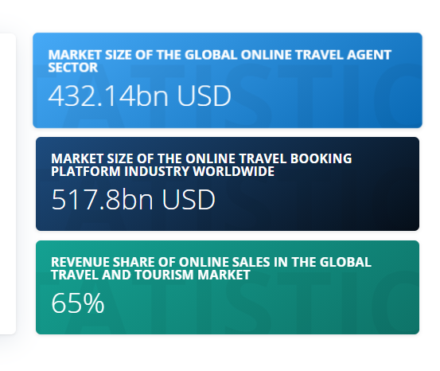
THE FUTURE OF TRAVEL BOOKING
In recent times, it has become more and more common for consumers to book trips themselves, particularly via OTAs (online traveling agency.
According to Statista, As of 2020, 65 percent of revenue in the global travel and tourism market came from online sales channels.
In that year, the online travel agent market size worldwide was approximately 432 billion U.S. dollars and it was forecast to reach over 833 billion U.S. dollars by 2025.

Slide 3
The online travel amazon's proposal
On demand : The customer could book the flight and be on the plane in less than 5 hours .
Price : The customer could search and book a flight at a savings of 30% cost of the average ticket price
By booking flight tickets on Amazon, customers can use their existing contact details and payment information, saving the effort of entering this information every time.

Slide 4







The competitors

Slide 5
Amazon’s Online Travel Strategy
Ease to use : Customers can use their existing contact details and payment information, saving the effort of entering this information every time.
Transparency : Customers can see the payable amount including all applicable charges such as convenience fees which are shown transparently.
Cancelation free :In case customers need to cancel a ticket, they only pay the airline cancellation penalty with Amazon not levying any additional charges.
Social Media : facebook, Instagram, Pintrest, and Youtube.
Internal Media : Current Azmon customers.

Slide 6
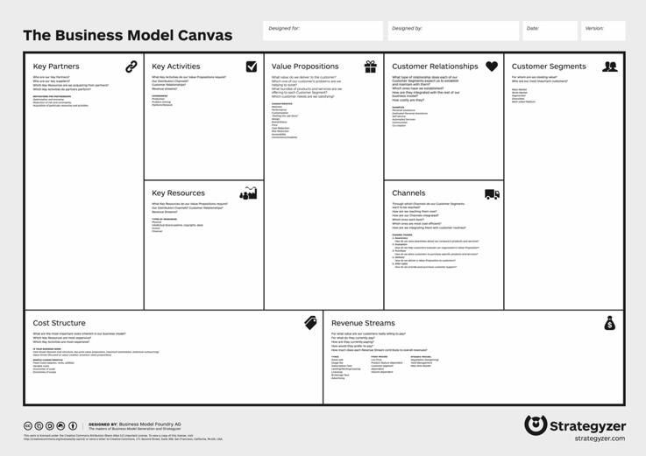
Amazon Business Model

Slide 7
Phases
Phase 1:
MVP - ability to book a flight in less than 5 hours on same day flights.
Phase 2:
All flights for 30% discount, add recommendations feature , add reviews.
Phase 3 :
Notifications for interested flights prices, integrations with different payments tools .

Slide 8
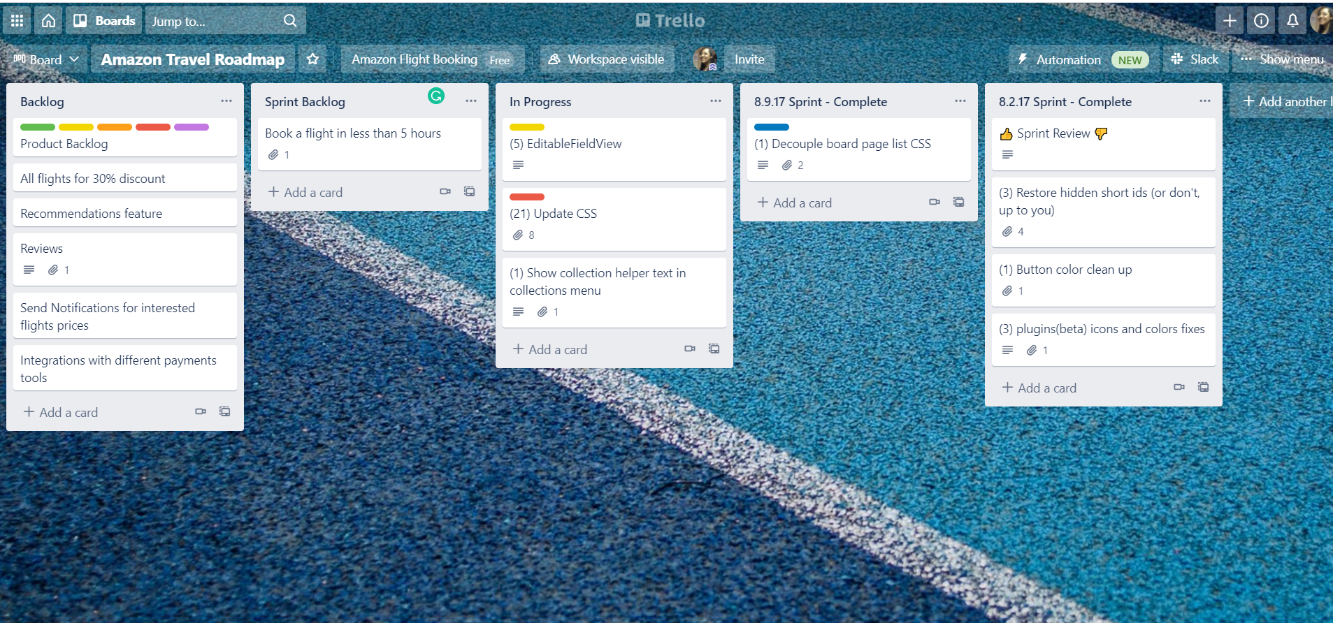
Roadmap
https://trello.com/b/DZfkgxOh/amazon-travel-roadmap

Slide 9
Solution Timeline
MVP phase 1
Phase 2
Phase 3
1 Sept
1 Nov
1 Jan
1 Mar
Sprint 3
Sprint 5
Sprint 1
Sprint 2
Sprint 4
1 Oct
1 Dec
1 Feb

Slide 10
Reference
https://www.statista.com/topics/2704/online-travel-market/
https://www.amazon.in/b?ie=UTF8&node=16985442031

